Slide 1
CWB Statistics
Notes:
This is the eighteenth and final presentation in the 18-part series for CWB training. The following slides cover how to view statistics in the CWB tool, once data is validated and certified.

Slide 2
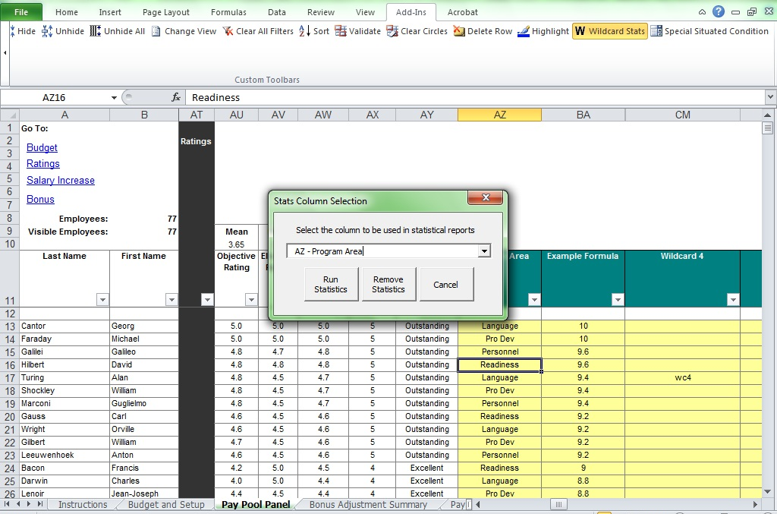
Wildcard Stats
Notes:
The Wildcard Stats button generates statistics broken out by any Wildcard column values (entered on the Pay Pool Panel worksheet) for the Rating Statistics and Bonus Statistics worksheets. You can enter wildcard values (formulas) before the import also.

Slide 3
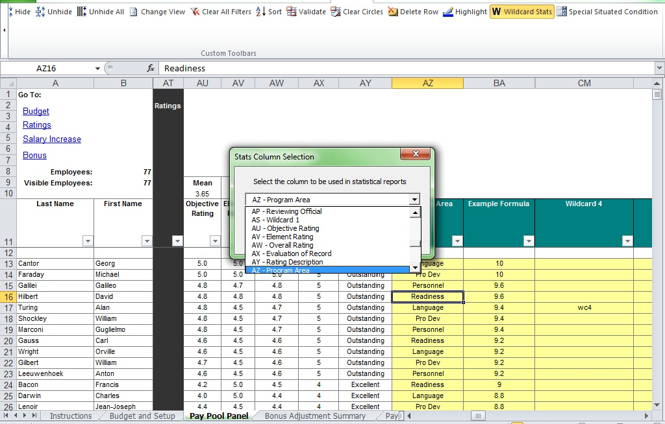
Wildcard Stats
Notes:
You can create Wildcard Stats on any column in the Pay Pool Panel worksheet. Select the field you want to generate stats for and then select the “Run Statistics” button in the pop-up interface. You will get a pop-up confirmation message stating “Wildcard Tables complete.”

Slide 4
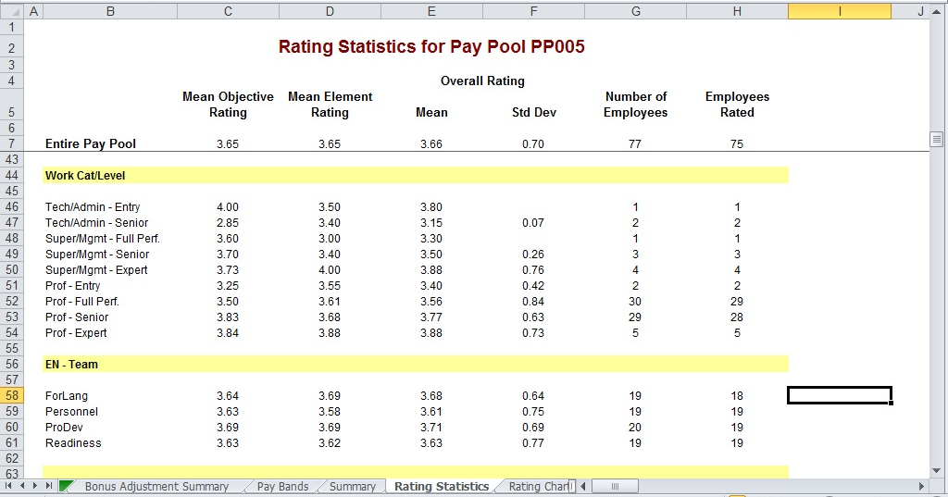
Rating Statistics
Notes:
The Rating Statistics worksheet, scrolled down to show the wildcard stats.

Slide 5
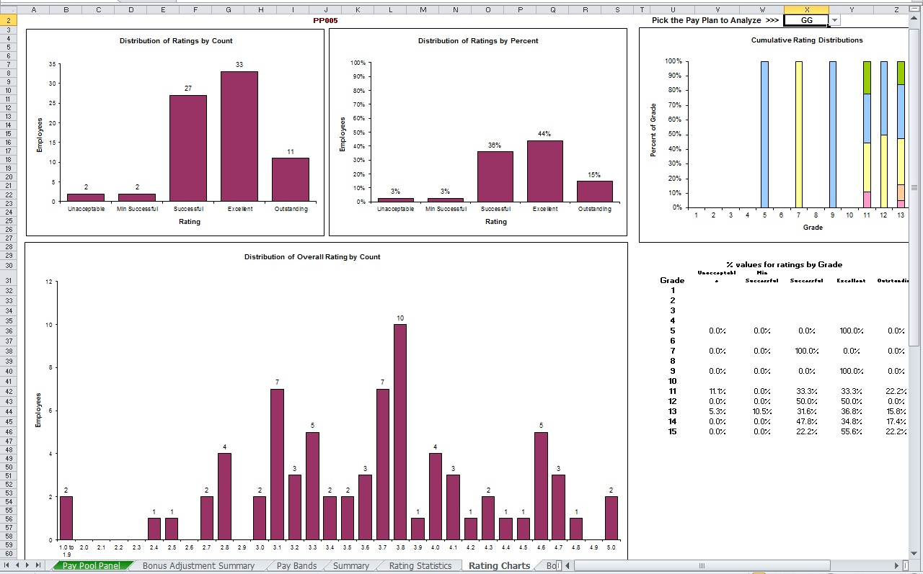
Rating Charts
Notes:
The Rating Charts worksheet. Select the pay plan to display in the “Cumulative Rating Distribution” chart, if there is more than one in the pay pool. One other chart is not shown here.

Slide 6
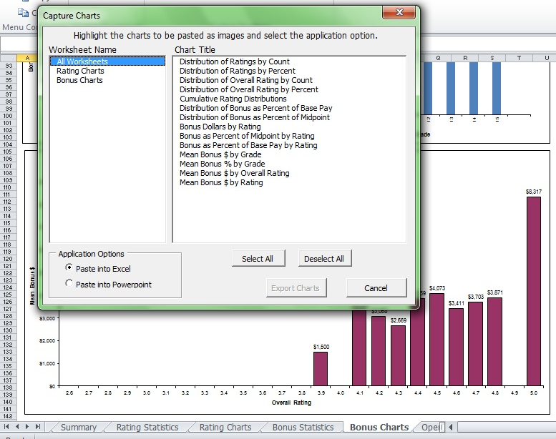
Capture Charts
Notes:
Capture Chart Images button on the toolbar brings up a list of worksheets that have charts, as well as the chart names.

Slide 7
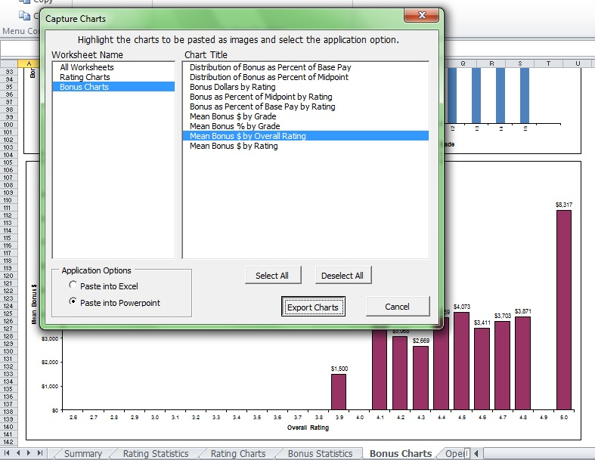
Capture Charts (Cont’d)
Notes:
Select which chart or charts you want to export.
Select whether you’re exporting to Excel or PowerPoint. This will paste a picture ONLY – not the underlying data.

Slide 8
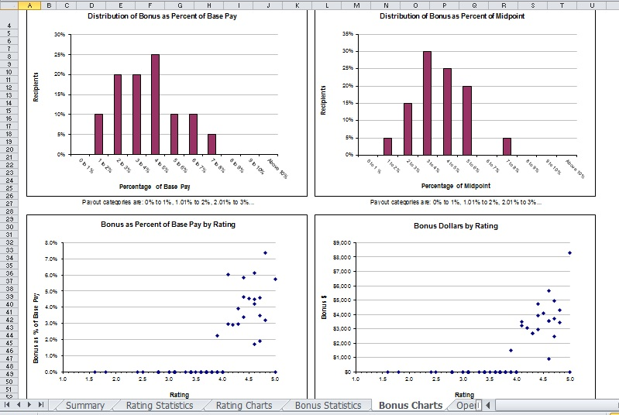
Bonus Charts
Notes:
Top of the Bonus Charts worksheet. Histograms and scatter plots.

Slide 9
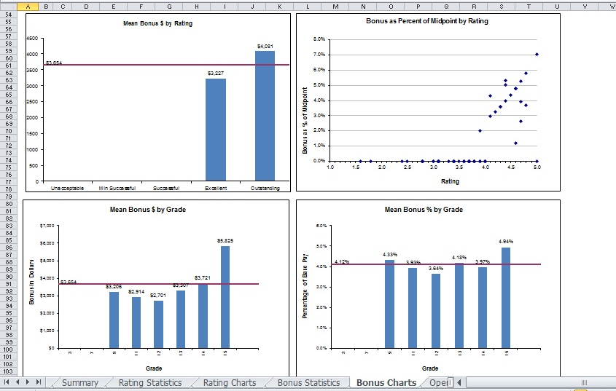
Bonus Charts
Notes:
Middle of the Bonus Charts worksheet. The bottom (not shown) includes a chart for mean bonus $ by overall (i.e. decimal) rating.

Slide 10
This completes the CWB training presentations
Notes:
This concludes the eighteenth and final presentation in the 18-part series for CWB training.

